Slide 1
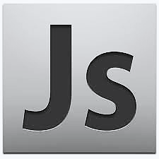
Introduction to JavaScript
Basic Syntax, Conditions and Loops
SoftUni Team
Technical Trainers
Software University
https://softuni.bg

Slide 2
Table of Contents
Introduction and IDE
JavaScript Syntax
Conditional Statements
Loops
While-Loop
For-Loop
Debugging and Troubleshooting

Slide 3
Have a Question?
sli.do
#fund-js

Slide 4

Introduction and IDE
Development Environments for JS

Slide 5
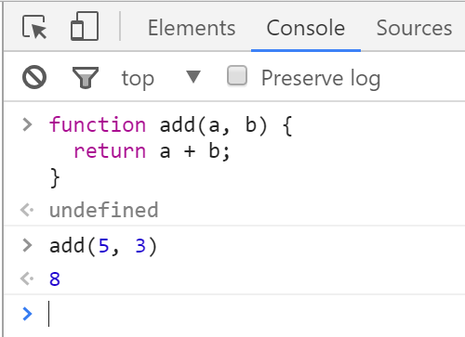

Chrome Web Browser
Developer Console: [F12]

Slide 6
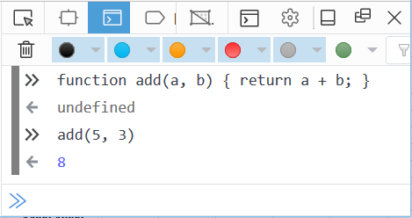

Firefox Web Browser
Developer Console: [Ctrl] + [Shift] + [i]

Slide 7
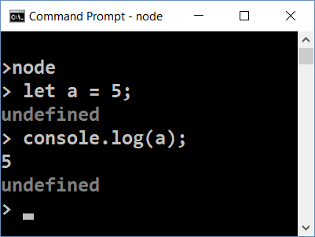
Node.js
What is Node.js?
Server-side JavaScript runtime
Chrome V8 JavaScript engine
NPM package manager
Install node packages

Slide 8
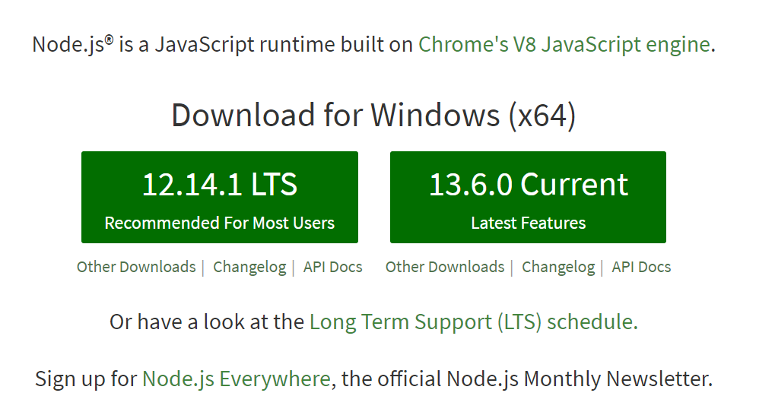
Install the Latest Node.js

Slide 9
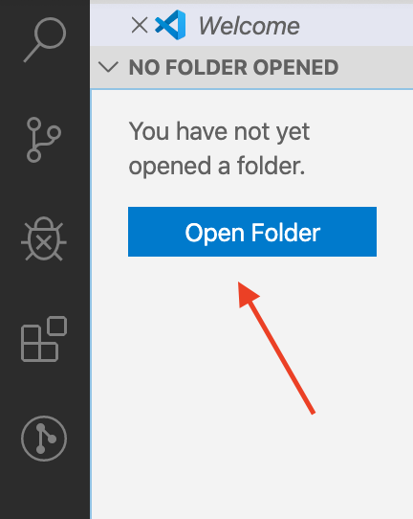
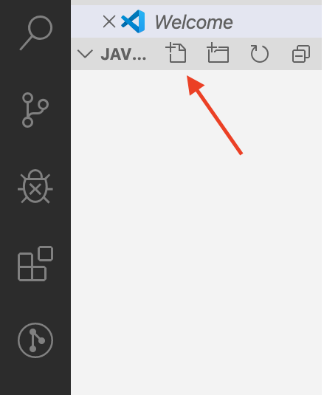
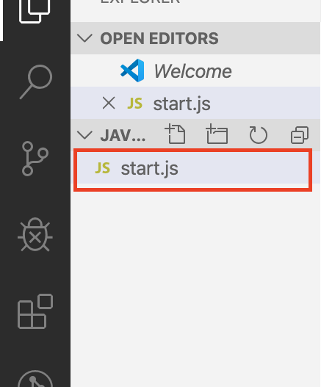
Using Visual Studio Code
Visual Studio Code is powerful text editor for JavaScript and other projects
In order to create your first project:

Slide 10
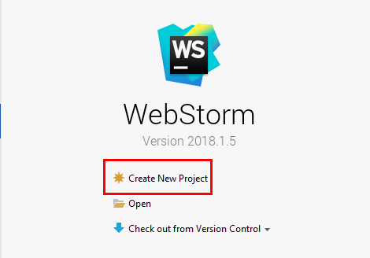
Using WebStorm
WebStorm is powerful IDE for JavaScript and other languages
Create a new project

Slide 11
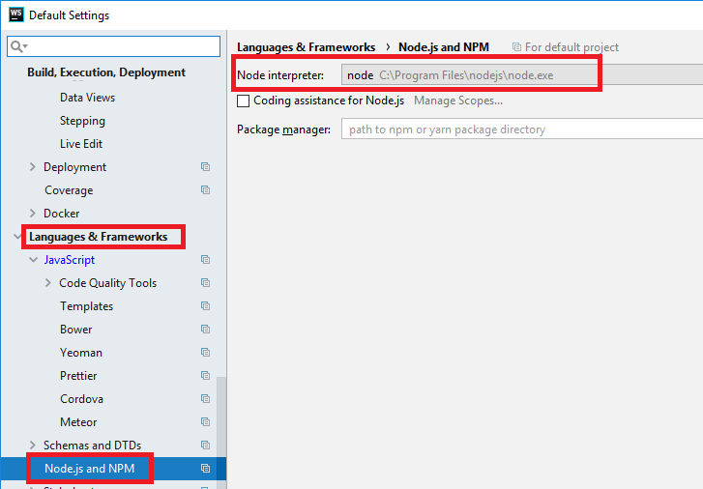
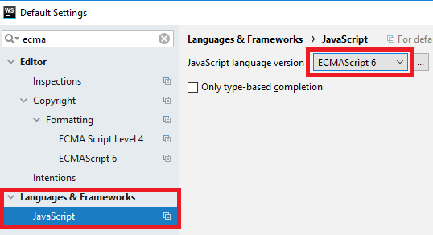
Configurations
Set up ECMAScript 6 and Node.js
ECMAScript6 is a standard for JavaScript
Node is environment for JavaScript

Slide 12
JavaScript Syntax
The JavaScript syntax is similar to C#, Java and PHP
Operators, Variables, Conditional statements, loops,
functions, arrays, objects and classes
let a = 5;
let b = 10;
if (b > a) {
console.log(b);
}
Declare a variable with let
Conditional statement
Body of the conditional statement

Slide 13
Functions
In order to solve different problems, we are going to use functions and the input will come as parameters
A function is block of code, that executes when called
declaration
parameters
function solve (num1, num2) { //some logic } solve(2, 3);
calling the function

Slide 14
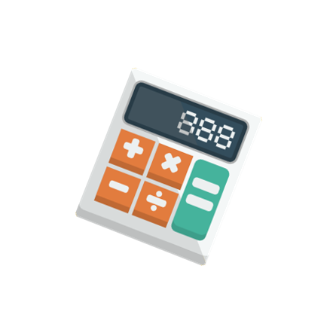
Problem: Multiply Number by Two
Write a function that receives a number and prints as result that number multiplied by two
Input
Output
2
4
function solve (num) {
console.log(num * 2);
}
solve(2);

Slide 15
Comparison Operators
Operator | Notation in JS
Equal value Equal value and type | == ===
Not equal value Not equal value/type | != !==
Greater than | >
Greater than or Equal | >=
Less than | <
Less than or Equal | <=

Slide 16
Conditional Statements
If (a > b)
Implementing Control-Flow Logic

Slide 17
What is Conditional Statement
The if-else statement:
Do action depending on condition
You can chain conditions
let a = 5;
if (a >= 5) {
console.log(a);
}
If the condition is met, the code will execute
else {
console.log('no');
}
Continue on the next condition, if the first is not met

Slide 18
Problem: Excellent Grade
Write a function that receives a single number and checks if the grade is excellent or not
If it is, print "Excellent", otherwise print "Not excellent"
function solve(grade){
if (grade >= 5.50) {
//TODO
} else {
//TODO
}
}
Input
Output
5.50
Excellent
4.35
Not excellent

Slide 19
Loops
for
while
Code Block Repetition

Slide 20
What Are Loops
The for loop:
Repeats until the condition is evaluated
The while loop:
Does the same, but has different structure
for (let i = 1; i <= 5; i++){
console.log(i)
}
Incrementation in the condition
let i = 1
while (i <= 5) {
console.log(i)
i++
}
Incrementation outside the condition

Slide 21
Problem: Numbers from 1 to 5
Create a function that prints all the numbers from 1 to 5 (inclusive) each on a separate line
Output
function solve () {
for (let i = 1; i <= 5; i++) {
//TODO: print
}
}
1
2
3
4
5

Slide 22
Problem: Numbers from N to 1
Write a function that receives a number and prints the numbers from N to 1. Try using a while loop
Input
Output
function solve(n) { while(/*TODO*/) { console.log(n); n--; } } solve(5);
5
5
4
3
2
1

Slide 23

Debugging the Code

Slide 24

Debugging the Code
The process of debugging application includes:
Spotting an error
Finding the lines of code that cause the error
Fixing the error in the code
Testing to check if the error is gone and no new errors are introduced
Iterative and continuous process

Slide 25
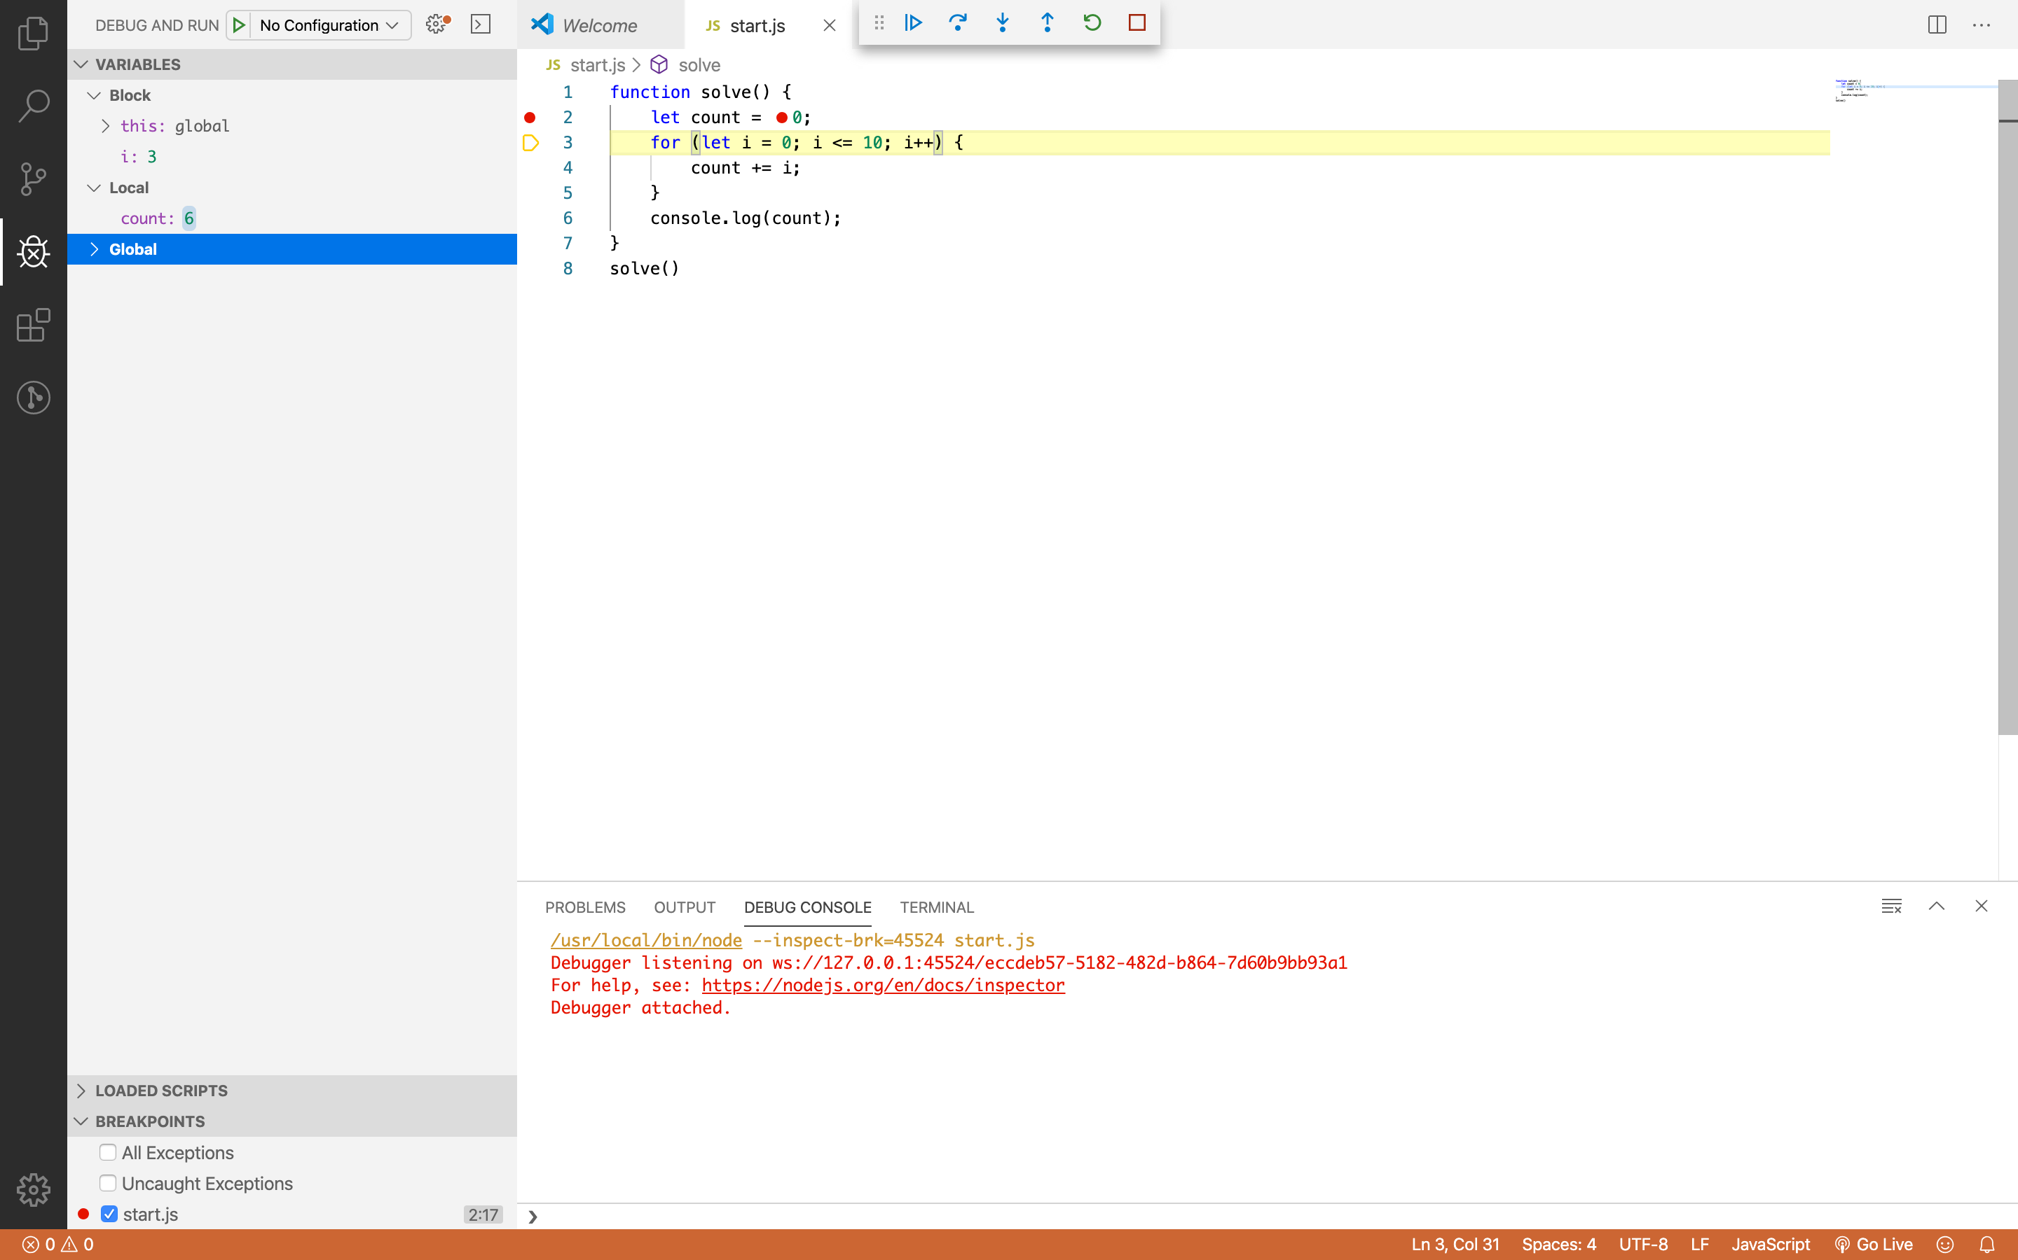
Debugging in Visual Studio Code
Visual Studio Code has a built-in debugger
It provides:
Breakpoints
Ability to trace the code execution
Ability to inspect variables at runtime

Slide 26
Using the Debugger in Visual Studio Code
Start without Debugger: [Ctrl+F5]
Start with Debugger: [F5]
Toggle a breakpoint: [F9]
Trace step by step: [F10]
Force step into: [F11]

Slide 27
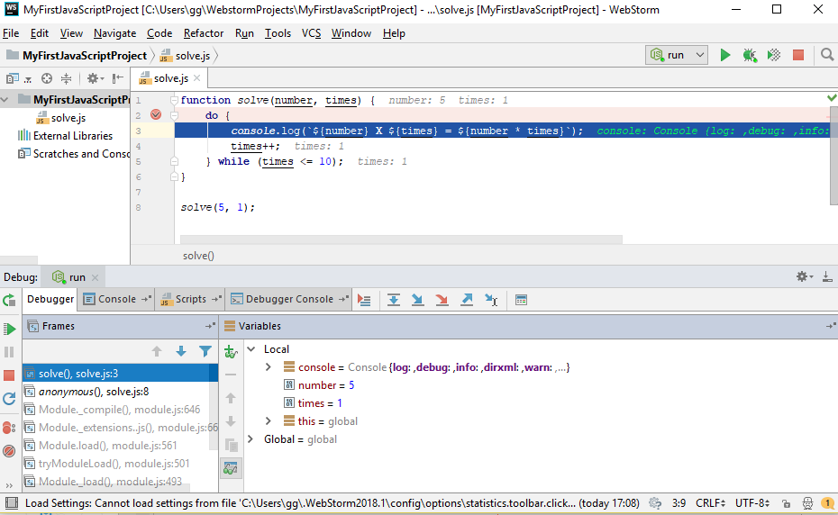
Debugging in WebStorm
WebStorm has a built-in debugger
It provides:
Breakpoints
Ability to trace the code execution
Ability to inspect variables at runtime

Slide 28
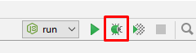
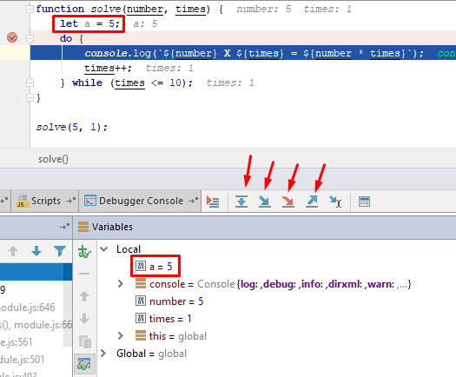
Using the Debugger in WebStorm
Start without Debugger: [Shift+F10]
Toggle a breakpoint: [Shift+F9]
Trace step by step: [F7]
Force step into: [Alt+Shift+f7]
Using the Local
Conditional breakpoints
Enter debug mode after exception

Slide 29

Live Exercises

Slide 30

Summary
…
…
…
Declare variables with 'let'
Use if-else statements to check for conditions
Use loops to avoid repeating code
Use the debugger to check for mistakes in the code

Slide 31
Questions?

Slide 32












SoftUni Diamond Partners

Slide 33




SoftUni Organizational Partners

Slide 34
Trainings @ Software University (SoftUni)
Software University – High-Quality Education, Profession and Job for Software Developers
softuni.bg, softuni.org
Software University Foundation
softuni.foundation
Software University @ Facebook
facebook.com/SoftwareUniversity
Software University Forums
forum.softuni.bg

Slide 35

License
This course (slides, examples, demos, exercises, homework, documents, videos and other assets) is copyrighted content
Unauthorized copy, reproduction or use is illegal
© SoftUni – https://softuni.org
© Software University – https://softuni.bg

